Slide 1
Mobile application Developments
Anuj Kumar

Slide 2
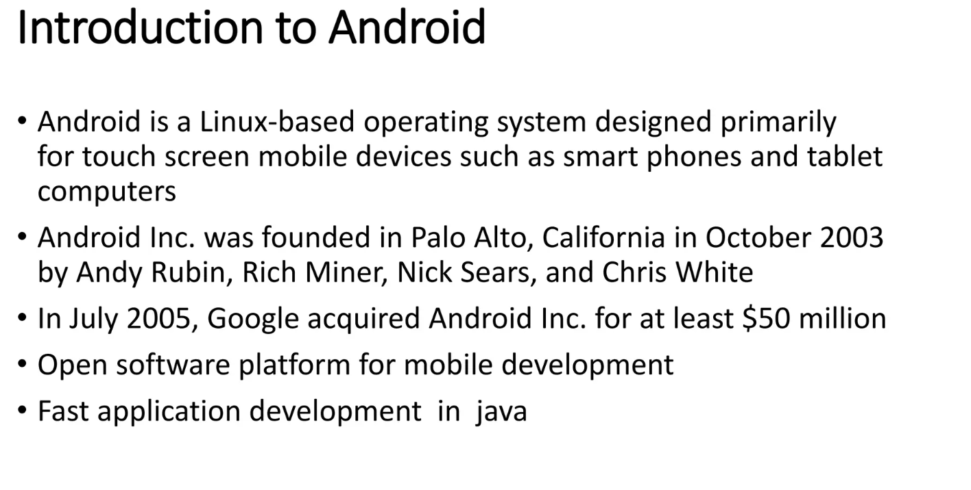

Slide 3
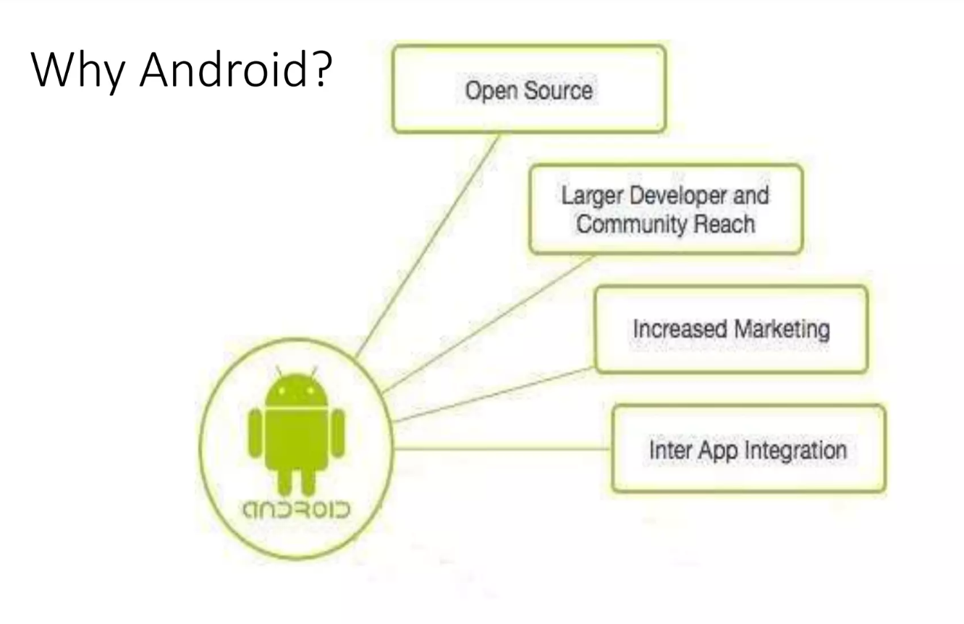

Slide 4
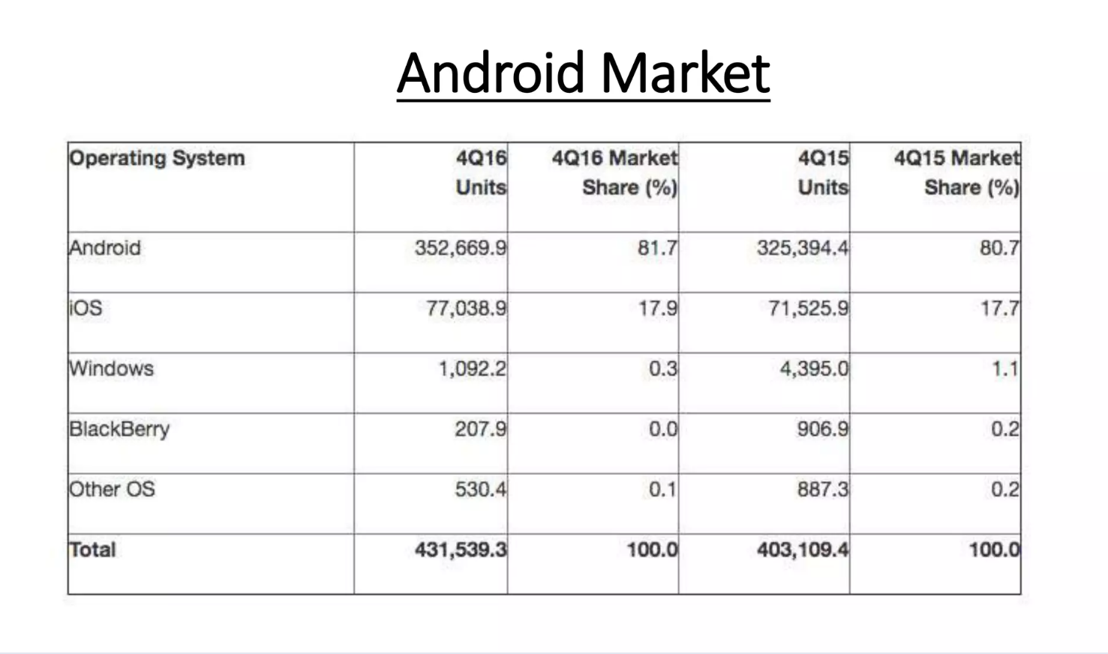

Slide 5
History:
Andy Rubin, Rich Miner, Nick Sears, and Chris White co-founded a start-up Android Inc. in Palo Alto, California. However, the company was later faced with the insufficiency of funds which brought Google into the picture. Google could sense the potential the product carried within and sealed a deal worth $50 Million to acquire Android in 2005. All the four Co-founders soon moved to the Googleplex to continue to develop the OS further under their new owners. The first public Android Beta Version 1.0 was finally published on 5th November 2007.
Open Handset Alliance (OHA):
It's a consortium of 84 companies such as google, samsung, AKM, synaptics, KDDI, Garmin, Teleca, Ebay, Intel etc.
It was established on 5th November, 2007, led by Google. It is committed to advance open standards, provide services and deploy handsets using the Android Plateform.

Slide 6
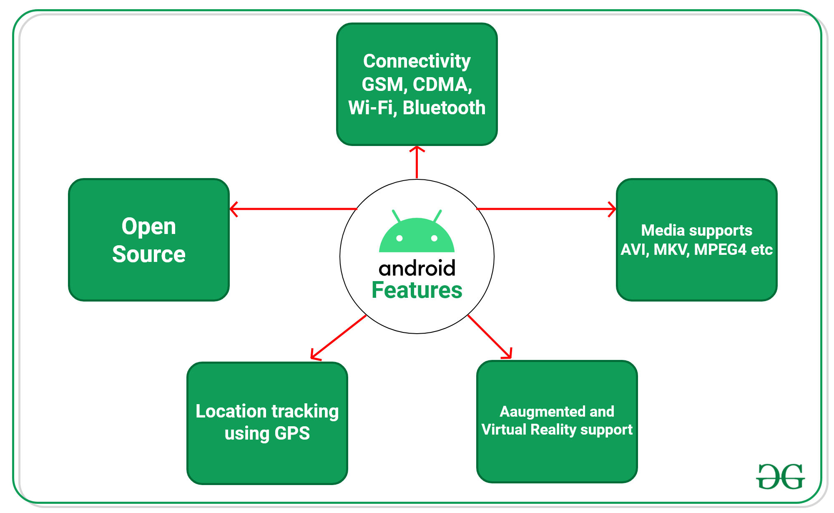
Feature of Android

Slide 7
Android is an Open Source Project so we can customize the OS based on our requirements.
Android supports different types of connectivity for GSM, CDMA, Wi-Fi, Bluetooth, etc. for telephonic conversation or data transfer.
Using wifi technology we can pair with other devices while playing games or using other applications.
It contains multiple APIs to support location-tracking services such as GPS.
We can manage all data storage-related activities by using the file manager.
It contains a wide range of media supports like AVI, MKV, FLV, MPEG4, etc. to play or record a variety of audio/video.

Slide 8
It also supports different image formats like JPEG, PNG, GIF, BMP, MP3, etc.
It supports multimedia hardware control to perform playback or recording using a camera and microphone.
Android has an integrated open-source WebKit layout-based web browser to support User Interfaces like HTML5, and CSS3.
Android supports multi-tasking means we can run multiple applications at a time and can switch between them.
It provides support for virtual reality or 2D/3D Graphics.

Slide 9
Android Version
Google first publicly announced Android in November 2007 but was released on 23 SEPTEMBER 2008 to be exact.
The first device to bring Android into the market was the HTC Dream with the version Android 1.0.

Slide 10
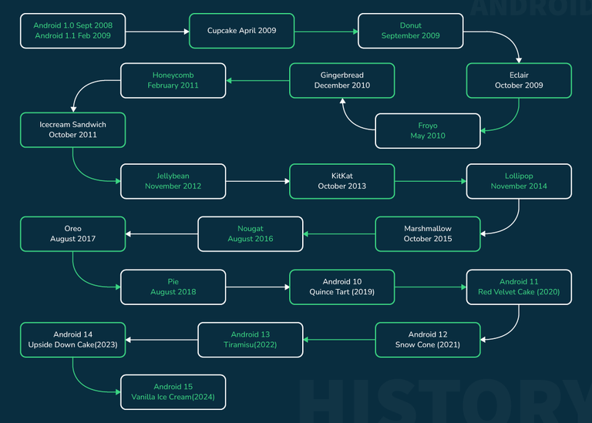

Slide 11
Code Name | Version | API level | Release date
- | Android 1.0 | 1 | September 23, 2008
- | Android 1.1 | 2 | February 9, 2009
Cupcake | Android 1.5 | 3 | April 30, 2009
Donut | Android 1.6 | 4 | September 15, 2009
Eclair | Android 2.0 - 2.1 | 5-7 | October 26, 2009
Froyo | Android 2.2 - 2.2.3 | 8 | May 20, 2010
Gingerbread | Android 2.3 - 2.3.4 | 9-10 | December 6, 2010
Honeycomb | Android 3.0.x - 3.2.x | 11 - 13 | February 22, 2011
Ice Cream Sandwich | Android 4.0 - 4.0.4 | 14 - 15 | October 18, 2011
Jelly Bean | Android 4.1 - 4.1.2 | 16 - 18 | July 9, 2012
Kitkat | Android 4.4 - 4.4.4 | 19 | July 9, 2012
Lollipop | Android 5.0 - 5.1 | 21 - 22 | October 17, 2014
Marshmallow | Android 6.0 - 6.0.1 | 23 | October 5, 2015
Nougat | Android 7.0 - 7.1 | 24 - 25 | August 22, 2016
Oreo | Android 8.0 | 26 | August 21, 2017
Pie | Android 9.0 | 27 | August 6, 2018
Android Q | Android 10.0 | 29 | September 3, 2019
Android 11 | Android 11.0 | 30 | September 8, 2020
Snow Cone | Android 12.0 - 12.1 | 31-32 | October 4, 2021
Tiramisu | Android 13 | 33 | August 15, 2022
Upside Down Cake | Android 14 | 34 | October 4, 2023
Vanilla Ice Cream | Android 15 | 35 | May 15, 2024

Slide 12
Programming Languages used in Developing Android Applications
Java
Kotlin
Developing the Android Application using Kotlin is preferred by Google, as Kotlin is made an official language for Android Development, which is developed and maintained by JetBrains. Previously before Java is considered the official language for Android Development. Kotlin is made official for Android Development in Google I/O 2017.

Slide 13
Advantages and Disadvantage of Android Development
Advantage
The Android is an open-source Operating system and hence possesses a vast community for support.
The design of the Android Application has guidelines from Google, which becomes easier for developers to produce more intuitive user applications.
Fragmentation gives more power to Android Applications. This means the application can run two activities on a single screen.
Releasing the Android application in the Google play store is easier when it is compared to other platforms.
Disadvantage
Fragmentation provides a very intuitive approach to user experience but it has some drawbacks, where the development team needs time to adjust to the various screen sizes of mobile smartphones.
The Android devices might vary broadly. So the testing of the application becomes more difficult.
As the development and testing consume more time, the cost of the application may increase, depending on the application's complexity and features.

Slide 14
Android Architecture:
------android architecture or Android software stack is categorized into five parts:
linux kernel
native libraries (middleware),
Android Runtime
Application Framework
Applications
1. Linux kernel
It is the heart of android architecture that exists at the root of android architecture. Linux kernel is responsible for device drivers, power management, memory management, device management and resource access.
2. Native Libraries
On the top of linux kernel, there are Native libraries such as WebKit, OpenGL, FreeType, SQLite, Media, C runtime library (libc) etc.

Slide 15
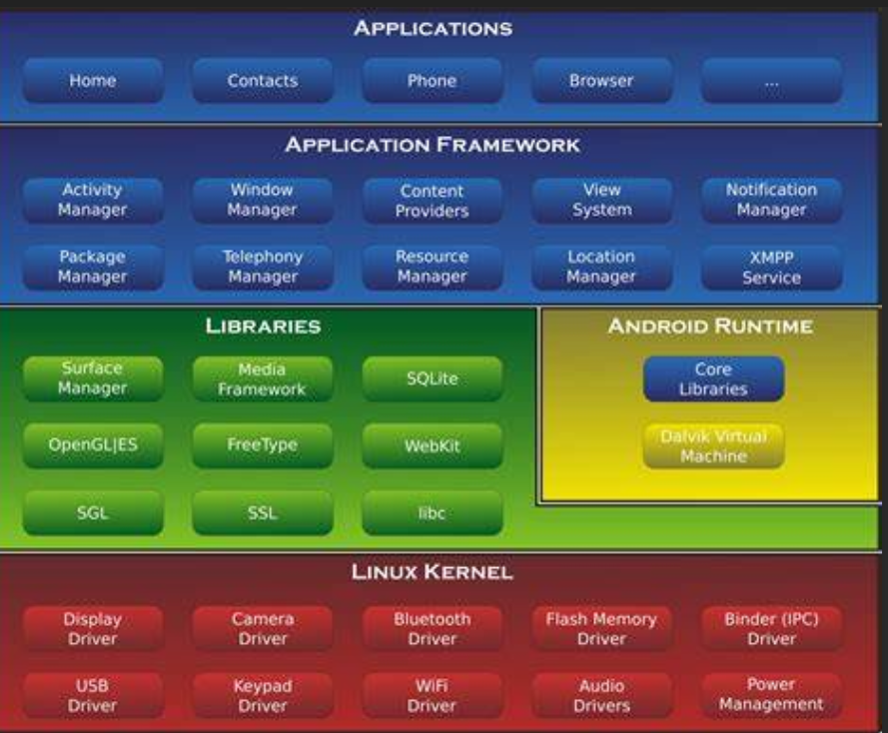

Slide 16
WebKit library- is responsible for browser support.
SQLite -is for database
FreeType-for font support.
Media framework- for playing and recording audio and video formats.
Surface manager-Composing window on screen.
SGL(scalable graphic library)- 2D graphics.
Open GL/ES- 3D graphics library.

Slide 17
Android Runtime:In android runtime, there are core libraries and DVM (Dalvik Virtual Machine) which is responsible to run android application. DVM is like JVM but it is optimized for mobile devices. It consumes less memory and provides fast performance
Android Framework:Android framework includes Android API's such as UI (User Interface), telephony, resources, locations, Content Providers (data) and package managers. It provides a lot of classes and interfaces for android application development.
Applications:
All applications such as home, contact, settings, games, browsers are using android framework that uses android runtime and libraries. Android runtime and native libraries are using linux kernal.

Slide 18
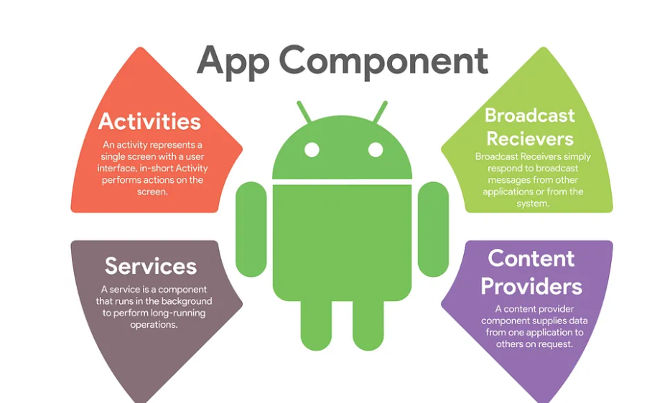
Component Of Android: There are four main Android app components: activities , services , content providers , and broadcast receivers .
Whenever you create or use any of them, you must include elements in the project manifest.
Activities
services
content providers
Broadcast receivers

Slide 19
Activities
Activities represent a single screen in an Android application.
They are responsible for interacting with the user and can contain UI elements.
Each activity has a lifecycle that defines its state transitions (e.g., onCreate, onStart, onResume, onPause, onStop, onDestroy).
public class MainActivity extends AppCompatActivity { @Override protected void onCreate(Bundle savedInstanceState) { super.onCreate(savedInstanceState); setContentView(R.layout.activity_main); // Your initialization code here } }

Slide 20
Services:
Services are used for long-running background tasks that don’t require a UI.
They run independently of the UI and can continue running even if the user switches to another app.
They have a lifecycle similar to activities (e.g., onCreate, onStartCommand, onDestroy).
public class MyService extends Service { @Override public int onStartCommand(Intent intent, int flags, int startId) { // Perform your background task here return START_STICKY; // Example of a sticky service } @Override public IBinder onBind(Intent intent) { return null; } }

Slide 21
Broadcast Receivers:(Responding To System-wide Announcements)
Broadcast receivers respond to system-wide broadcast announcements known as Intents. They act as gateways into your app through which these signals flow, serving functions such as alerting you when your device’s battery is low or indicating Wi-Fi connectivity status.
Broadcast receivers respond to system-wide events or custom broadcasts sent within the application.
They are used to perform actions based on received broadcasts.
They don’t have a UI and are typically short-lived.
public class MyReceiver extends BroadcastReceiver { @Override public void onReceive(Context context, Intent intent) { // Handle the received broadcast here } }

Slide 22
Content Providers: ( Data Management Specialists)
A content provider manages access to structured sets of application data. This component allows applications to query data (including images and audio files) stored privately within their own sandboxed environment or shared across multiple applications.
Content providers manage shared sets of application data.
They are used to store and retrieve data from a central repository, such as a database.
They provide a standardized way of accessing data that can be shared across different applications.

Slide 23
Content Providers:
public class MyContentProvider extends ContentProvider
{ @Override public boolean onCreate()
{ // Initialize your content provider here return true; }@Override public Cursor query(Uri uri, String[] projection, String selection, String[] selectionArgs, String sortOrder)
{ // Perform a query on the underlying data source return null; }// Other ContentProvider methods (insert, update, delete) omitted for brevity
}

Slide 24
Activity and Its Life Cycle:
Activities are said to be the presentation layer of our applications. The UI of our application is built around one or more extensions of the Activity class.
An activity is the entry point for interacting with the user. Every activity contains the layout, which has a user interface to interact with the user. An activity is implemented as a subclass of class Activity.
Layout for a particular activity is set with the help of setContentView(). setContentView() is a function that takes View as a parameter. The view parameter basically contains the layout file for that activity.
public class MainActivity extends Activity {
}

Slide 25
Activity class is one of the very important parts of the Android Component. Any app, don't matter how small it is (in terms of code and scalability), has at least one Activity class.
Unlike most programming languages, in which the main() method is the entry point for that program or application to start its execution, the android operating system initiates the code in an Activity instance by invoking specific callback methods that correspond to specific stages of its Lifecycle. So it can be said that An activity is the entry point for interacting with the user.
Every activity contains the layout, which has a user interface to interact with the user. As we know that every activity contains a layout associated with it, so it can be said that the activity class is the gateway, through which a user can interact programmatically with the UI.
Layout for a particular activity is set with the help of setContentView(). setContentView() is a function that takes View as a parameter. The view parameter basically contains the layout file for that activity

Slide 26
There are two methods almost all subclasses of Activity will implement:
onCreate()
onPause()
onCreate() Method
onCreate(Bundle) method is the place, where the user initializes the activity. This method is called when the activity is starting. This is the method that is used to initialize most of the things in the android app. onCreate() method takes savedInstanceState as the parameter, which the object of type Bundle, i.e Bundle Object which contains the previously saved data of the activity. If the activity is newly created then the bundle won't be saving any data of the activity and would contain the null value.
onCreate() method calls the setContentView() method to set the view corresponding to the activity. By default in any android application, setContentView point to activity_main.xml file, which is the layout file corresponding to MainActivity. The onCreate method uses the findViewById() method so that the user can interact programmatically with the widgets in android and then customize them according to need.

Slide 27
import androidx.appcompat.app.AppCompatActivity;
import android.os.Bundle;
public class MainActivity extends AppCompatActivity
{
@Override
protected void onCreate(Bundle savedInstanceState)
{
super.onCreate(savedInstanceState);
setContentView(R.layout.activity_main);
}
}
protected void onCreate(Bundle savedInstanceState) method:
This method is called when the activity is starting. This is the method that is used to initialize most of the things in the android app.
onCreate() method takes savedInstanceState as the parameter, which the object of type Bundle.
Bundle Object contains the previously saved data of the activity.
If the activity is newly created then the bundle won't be saving any data of the activity and would contain the null value.

Slide 28
onCreate() method:
It calls the setContentView() method to set the view corresponding to the activity.
By default in any android application, setContentView point to activity_main.xml file, which is the layout file corresponding to MainActivity.
The onCreate method uses the findViewById() method so that the user can interact programmatically with the widgets in android and then customize them according to need.
Bundle Class:
If the activity is being re-initialized or restarted after previously being closed, then this Bundle contains the data it most recently supplied in onSaveInstanceState(Bundle).
onSaveInstanceState() method is the method that is called to save the data just before our activity is killed.
onPause() Method: To stop the activity – protected void onPause()
{
super.pause();
}

Slide 29
Declaring Activity in Manifest File:
To declare your activity, open your manifest file and add an <activity> element as a child of the <application> element.
<manifeast………..>
<application…….>
<activity android:name=“.ExampleActivity/>
</application>
-----------
</manifiest>
<
The only required attribute for this element is android:name, which specifies the class name of the activity. You can also add attributes that define activity characteristics such as label, icon, or UI theme.

Slide 30
<?xml version="1.0" encoding="utf-8"?>
<manifest xmlns:android="http://schemas.android.com/apk/res/android"
xmlns:tools="http://schemas.android.com/tools"
package="com.gfg.exampleactivity">
<application
android:allowBackup="true"
android:dataExtractionRules="@xml/data_extraction_rules"
android:fullBackupContent="@xml/backup_rules"
android:icon="@mipmap/ic_launcher"
android:label="@string/app_name"
android:roundIcon="@mipmap/ic_launcher_round"
android:supportsRtl="true"
android:theme="@style/Theme.ExampleActivity"
tools:targetApi="31">
<activity
android:name=".MainActivity"
android:exported="true">
<intent-filter>
<action android:name="android.intent.action.MAIN" />
<category android:name="android.intent.category.LAUNCHER" />
</intent-filter>
</activity>
</application>
</manifest>

Slide 31
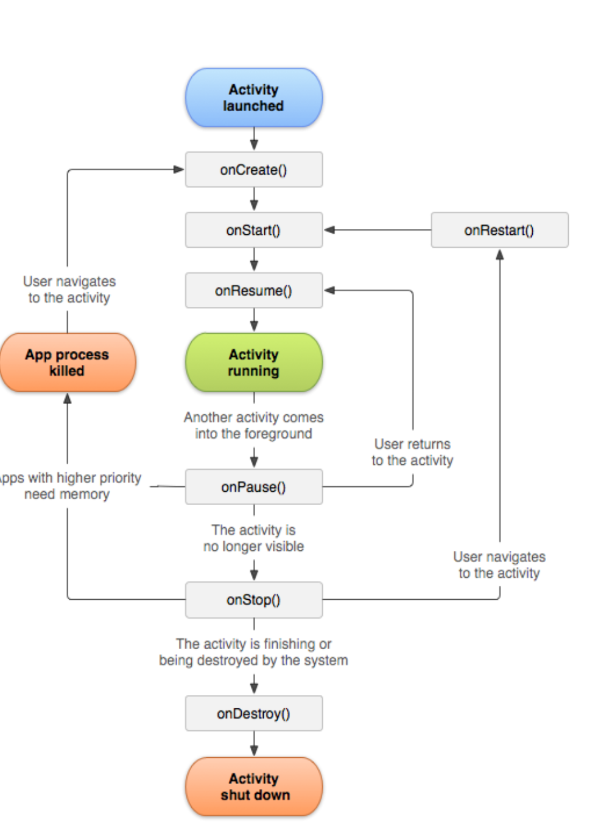

Slide 32
Activity-lifecycle concepts:
To navigate transitions between stages of the activity lifecycle, the Activity class provides a core set of six callbacks:
onCreate()
onStart()
onResume()
onPause()
onStop()
onDestroy().
The system invokes each of these callbacks as the activity enters a new state.

Slide 33
1. onCreate()
This method is called when the activity is first created. It is responsible for initializing the activity’s UI, such as inflating the layout and finding the views.
2. onStart()
This method is called when the activity becomes visible to the user. It is a good place to start animations and other visual changes.
3. onResume()
This method is called when the activity becomes the foreground activity. It is the state in which the user can interact with the activity. This is where you should register any listeners or start any services that need to be running while the activity is in the foreground.
4. onPause()
This method is called when the activity is no longer the foreground activity. It is a good place to unregister listeners, save any data that needs to be saved, and stop any services that don’t need to be running in the background.
5. onStop()
This method is called when the activity is no longer visible to the user. It is a good place to stop animations and other visual changes.
6. onDestroy()
This method is called when the activity is about to be destroyed. It is a good place to release any resources and clean up any remaining data.

Slide 34
public class MainActivity extends AppCompatActivity
{ @Override protected void onCreate(Bundle savedInstanceState)
{ super.onCreate(savedInstanceState); setContentView(R.layout.activity_main); // Initialize UI components and load data Log.d("Lifecycle", "onCreate"); } @Override protected void onStart() { super.onStart(); // Start animations or visual effects Log.d("Lifecycle", "onStart"); }
@Override protected void onResume() { super.onResume(); // Start playing media Log.d("Lifecycle", "onResume"); }
@Override protected void onPause() { super.onPause(); // Save data, stop background processes Log.d("Lifecycle", "onPause");}
@Override protected void onStop() { super.onStop(); // Release resources Log.d("Lifecycle", "onStop");} @Override protected void onRestart() { super.onRestart(); // Restore state Log.d("Lifecycle", "onRestart"); } @Override protected void onDestroy() { super.onDestroy(); // Release all resources Log.d("Lifecycle", "onDestroy"); }}

Slide 35
2. Services:
A service is simply processing in background while app is running. It is a component that works in the background to perform operations.
For instance, service can play music in the background while user is dealing with other apps or can get data from network without any user interaction.
service is implemented as a subclass of Service class.
public class MyService extends Service
{ }

Slide 36
3.Content providers
Content Provider component is providing data from one application to others on request. These requests are handled by the “ContentResolver” class methods. Data might be stored in the system, databases or somewhere else.
A content provider is implemented as a subclass of ContentProvider.
public class MyContentProvider extends ContentProvider
{ public void onCreate(){} }

Slide 37
4.Broadcast receivers:
Broadcast Receivers answer to broadcast messages from another applications or system. For example, to deliver other apps know that some data downloaded to the device and available for use. Even though broadcast receivers do not show user interface, they might create status bar notification to user for events.
A broadcast receiver is implemented as a subclass of BroadcastReceiver. Each broadcast is delivered as an Intent object.
public class MyReceiver extends BroadcastReceiver
{ public void onReceive(context,intent)
{
} }

Slide 38
AndroidManifest.xml:
The AndroidManifest.xml file contains information of your package, including components of the application such as activities, services, broadcast receivers, content providers etc.
It performs some other tasks also:
It is responsible to protect the application to access any protected parts by providing the permissions.
It also declares the android api that the application is going to use.
It lists the instrumentation classes. The instrumentation classes provides profiling and other information. These information are removed just before the application is published etc.
This is the required xml file for all the android application and located inside the root directory.

Slide 39
<manifest xmlns:android="http://schemas.android.com/apk/res/android"
package="com.MyApplication.hello"
android:versionCode="1"
android:versionName="1.0" >
<uses-sdk
android:minSdkVersion="8"
android:targetSdkVersion="15" />
<application
android:icon="@drawable/ic_launcher"
android:label="@string/app_name"
android:theme="@style/AppTheme" >
<activity
android:name=".MainActivity"
android:label="@string/title_activity_main" >
<intent-filter>
<action android:name="android.intent.action.MAIN" />
<category android:name="android.intent.category.LAUNCHER" />
</intent-filter>
</activity>
</application>
</manifest>

Slide 40
Elements of the AndroidManifest.xml file
The elements used in the above xml file are described below.
<manifest>
manifest is the root element of the AndroidManifest.xml file. It has package attribute that describes the package name of the activity class.
<application>
application is the sub element of the manifest. It includes the namespace declaration. This element contains several sub elements that declares the application component such as activity etc.
The commonly used attributes are of this element are icon, label, theme etc.
android:icon represents the icon for all the android application components.
android:label works as the default label for all the application components.
android:theme represents a common theme for all the android activities.

Slide 41
<activity>
activity is the sub element of application and represents an activity that must be defined in the AndroidManifest.xml file. It has many attributes such as label, name, theme, launch Mode etc.
android:label represents a label i.e. displayed on the screen.
android:name represents a name for the activity class. It is required attribute.
<intent-filter>
intent-filter is the sub-element of activity that describes the type of intent to which activity, service or broadcast receiver can respond to.
<action>
It adds an action for the intent-filter. The intent-filter must have at least one action element.
<category>
It adds a category name to an intent-filter.

Slide 42
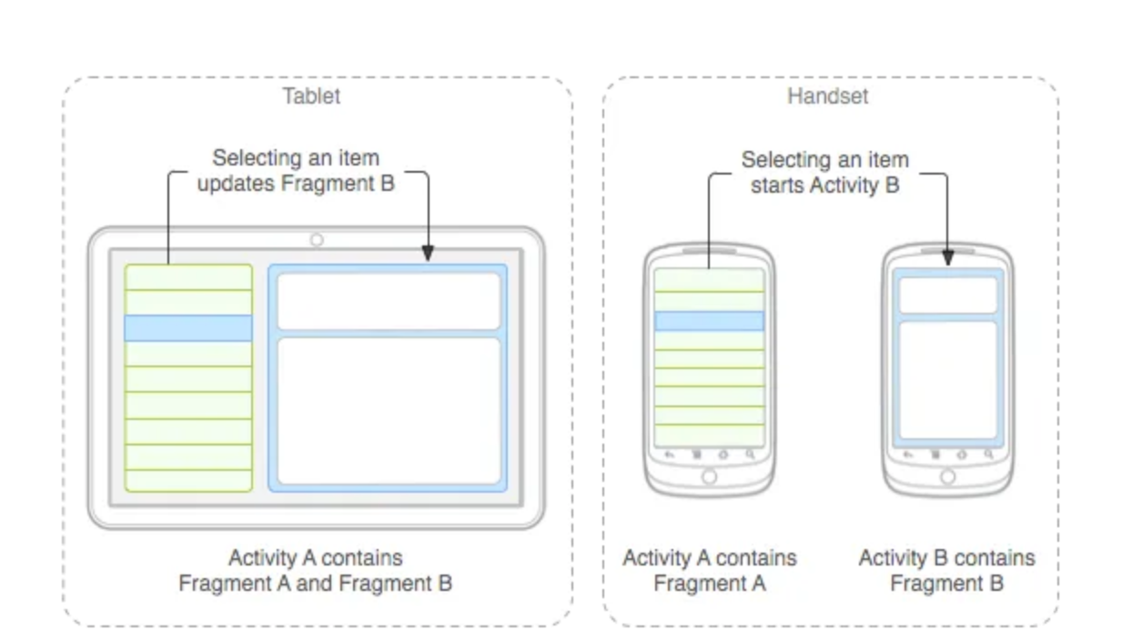
Fragments:
Represents a portion of user interface in an Activity. A fragment encapsulates functionality so that it is easier to reuse within activities and layouts.
Fragments simplify the reuse of components in different layouts and their logic.
You can also use fragments also to support different layouts for landscape and portrait orientation on a smartphone

Slide 43
Toast Message: It is used to display information for short period of time. A toast contain message to be displayed quickly and disappear after some time.
A Toast is a feedback message. It takes a very little space for displaying while the overall activity is interactive and visible to the user. It disappears after a few seconds. It disappears automatically. If the user wants a permanently visible message, a Notification can be used. Another type of Toast is custom Toast, in which images can be used instead of a simple message.
The android.widget.Toast class is the subclass of java.lang.Oject class.
Toast class provides a simple popup message that is displayed on the current activity UI screen (e.g. Main Activity).
There are two classes:
public static final int LENGTH_LONG | Displays view for the along duration of time
public static final int LENGTH_SHORT | Displays for a short duration of time

Slide 44
Methods of Toast:
1- public static Toast makeText(Context context, CharSequence text, int duration)
-makes the toast message consist of text and time duration
Use makeText() Method , which take the following parameters
1-The activity Context: context: A first parameter is a Context object which is obtained by calling getApplicationContext().
2-The text that should appear to the user.
3-The duration that the toast should remain on the screen.
-This method return a properly initialized Toast Object
2-public void show()
-displays a toast message
3-public void setMargin (float horizontalMargin, float verticalMargin)
-changes the horizontal and vertical differences

Slide 45
Toast.makeText(getApplicationContext(), "This a toast message", Toast.LENGTH_LONG).show();
OR
Toast toast= toast.makeText(getApplicationContext(), "This a toast message", Toast.LENGTH_SHORT);
Toast.setMargin(50,50);
Toast.show();

Slide 46
import android.support.v7.app.AppCompatActivity;
import android.os.Bundle;
import android.view.View;
import android.widget.Button;
import android.widget.Toast;
public class MainActivity extends AppCompatActivity {
// Defining the object for button
Button btn;
@Override
protected void onCreate(Bundle savedInstanceState) {
super.onCreate(savedInstanceState);
setContentView(R.layout.activity_main);
// Bind the components to their respective objects by assigning
// their IDs with the help of findViewById() method
Button btn = (Button)findViewById(R.id.Button01);
btn.setOnClickListener(new View.OnClickListener() {
@Override
public void onClick(View v) {
// Displaying simple Toast message
Toast.makeText(getApplicationContext(), "This a toast message", Toast.LENGTH_LONG).show();
}
});
}
}

Slide 47
Change the position of a Toast Message:
If there is a need to set the position of a Toast message, then setGravity() method can be used
Parameters: This method accepts three parameters:
gravity: This sets the position of the Toast message. The following constants can be used to specify the position of a Toast:
1.TOP
2.BOTTOM
3.LEFT
4.RIGHT
5.CENTER
6.CENTER_HORIZONTAL
7.CENTER_VERTICAL

Slide 48
Every constant specifies the position in the X and Y axis, except the CENTER constant which sets the position centered for both horizontal and vertical directions.
xOffset: This is the offset value that tells how much to shift the Toast message horizontally on the x-axis.
yOffset: This is the offset value that tells how much to shift the Toast message vertically on the y-axis.
Toast t = Toast.makeText(getApplicationContext(), "This a positioned toast message", Toast.LENGTH_LONG);
t.setGravity(Gravity.BOTTOM | Gravity.RIGHT, 0, 0); t.show();

Slide 49
Intent in Android
The intent is a messaging object which passes between components like services, content providers, activities, etc.
Normally startActivity() method is used for invoking any activity
Intents are used for navigating among various activities within the same application, but note, is not limited to one single application, i.e., they can be utilized from moving from one application to another as well.
Function of Intent:
Start service
Launch Activity
Display web page
Display contact list
Message broadcasting

Slide 50
Some Important Method
Applications of Intents:
Sending the User to Another App
Getting a Result from an Activity
Allowing Other Apps to Start Your Activity
Some Important Method of Intent and their Description
Context.startActivity()-This is to launch a new activity or get an existing activity to be action.
Context.startService():-This is to start a new service or deliver instructions for an existing service.
Context.sendBroadcast():This is to deliver the message to broadcast receivers.

Slide 51
Type of Intent
There are two types of intents in android
Implicit
Explicit
Implicit Intent: Implicit Intent doesn't specify the component. In such a case, intent provides information on available components provided by the system that is to be invoked.
For example, you may write the following code to view the webpage.

Slide 52
Example: you may write the following code to view the webpage
Intent intent=new Intent(Intent.ACTION_VIEW); intent.setData(Uri.parse("https://www.google.com/")); startActivity(intent);
Dial a Number:
Intent(Intent.ACTION_DIAL, Uri.parse("tel:5551234")).
SendEmail:
Intent intent=new Intent(Intent.ACTION_SENDTO)
intent. setData(Uri.parse("mailto:..."))

Slide 53
Example
public class MainActivity extends AppCompatActivity
{
@Override
protected void onCreate(Bundle savedInstanceState)
{
EditText editText;
Button button;
super.onCreate(savedInstanceState);
setContentView(R.layout.activity_main);
button = findViewById(R.id.btn); editText = (EditText) findViewById(R.id.editText);
button.setOnClickListener(new View.OnClickListener() {
@Override
public void onClick(View view)
{
String url=editText.getText().toString();
Intent intent = new Intent(Intent.ACTION_VIEW, Uri.parse(url));
startActivity(intent);
} });
} }

Slide 54
Layouts in views
Android Layout is used to define the user interface that holds the UI controls or widgets that will appear on the screen of an android application or activity screen.
Generally, every application is a combination of View and ViewGroup.
The android application contains a large number of activities and we can say each activity is one page of the application. So, each activity contains multiple user interface components and those components are the instances of the View and ViewGroup.
All the elements in a layout are built using a hierarchy of View and ViewGroup objects.

Slide 55
Explicit Intent
Explicit Intent specifies the component. In such a case, intent provides the external class to be invoked.
Intent i = new Intent(getApplicationContext(), ActivityTwo.class);
startActivity(i);

Slide 56
Example:
public class MainActivity extends AppCompatActivity
{
@Override
protected void onCreate(Bundle savedInstanceState)
{
super.onCreate(savedInstanceState); setContentView(R.layout.activity_main);
}
public void newsScreen(View view)
{
Intent i = new Intent(getApplicationContext(), MainActivity2.class);
startActivity(i);
} }

Slide 57
Method
putExtra(), getContent()
and getStringExtra()

Slide 58
Layouts in views
A layout defines the structure for a user interface in your app, such as in an activity. All elements in the layout are built using a hierarchy of View and ViewGroup objects.
A View usually draws something the user can see and interact with.
A ViewGroup is an invisible container that defines the layout structure for View and other ViewGroup objects.

Slide 59
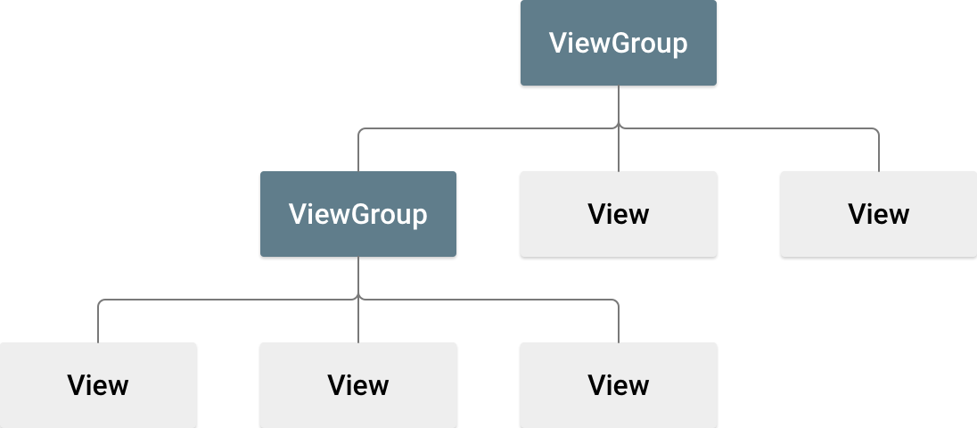
Layout View

Slide 60
View
A View is defined as the user interface which is used to create interactive UI components such as TextView, ImageView, EditText, RadioButton, etc., and is responsible for event handling and drawing.
View objects are often called widgets and can be one of many subclasses, such as Button or TextView.

Slide 61
View Group
A ViewGroup act as a base class for layouts and layouts parameters that hold other Views or View Groups and to define the layout properties.
The ViewGroup objects are usually called layouts and can be one of many types that provide a different layout structure, such as LinearLayout or ConstraintLayout.

Slide 62
The Android framework will allow us to use UI elements or widgets in two ways:
Use UI elements in the XML file
Create elements in the java file dynamically
Declare UI elements in XML. Android provides a straightforward XML vocabulary that corresponds to the View classes and subclasses,
such as those for widgets and layouts. You can also use Android Studio's Layout Editor to build your XML layout using a drag-and-drop interface.
Instantiate layout elements at runtime. Your app can create View and ViewGroup objects and manipulate their properties programmatically.

Slide 63
Layout
Each layout file must contain exactly one root element, which must be a View or ViewGroup object.
After you define the root element, you can add additional layout objects or widgets as child elements to gradually build a View hierarchy that defines your layout.

Slide 64
Load the XML resource
When you compile your app, each XML layout file is compiled into a View resource. Load the layout resource in your app's Activity.onCreate() callback implementation. Do so by calling setContentView(), passing it the reference to your layout resource in the form: R.layout.layout_file_name.
public void onCreate(Bundle savedInstanceState)
{
super.onCreate(savedInstanceState);
setContentView(R.layout.main_layout);
}

Slide 65
Types of Android Layout
Android Linear Layout: LinearLayout is a ViewGroup subclass, used to provide child View elements one by one either in a particular direction either horizontally or vertically based on the orientation property.
Arranges its children in a single direction, either horizontally or vertically.
Children are placed one after the other, and they can occupy either the width or height of the layout depending on the orientation.
It supports weight attribute, which helps distribute the remaining space among children based on their assigned weight.
Commonly used when a straightforward, ordered arrangement of views is needed.
Simple forms, buttons aligned in a row or column.

Slide 66
Write the XML
<?xml version="1.0" encoding="utf-8"?>
<LinearLayout
xmlns:android="http:// schemas.android.com/apk/res/android"
xmlns:tools="http:// schemas.android.com/tools"
android:orientation="vertical"
android:layout_width="match_parent"
android:layout_height="match_parent"
tools:context=".MainActivity">
<!--EditText with id editText-->
<EditText
android:id="@+id/editText"
android:layout_width="match_parent"
android:layout_height="wrap_content"
android:layout_margin="16dp"
android:hint="Input"
android:inputType="text"/>
<!--Button with id showInput-->
<Button
android:id="@+id/showInput"
android:layout_width="wrap_content"
android:layout_height="wrap_content"
android:layout_gravity="center_horizontal"
android:text="show"
android:backgroundTint="@color/colorPrimary"
android:textColor="@android:color/white"/>
</LinearLayout>

Slide 67
XML Example (Vertical):
<LinearLayout
xmlns:android="http://schemas.android.com/apk/res/android"
android:layout_width="match_parent"
android:layout_height="match_parent"
android:orientation="vertical"
android:padding="16dp">
<TextView
android:layout_width="wrap_content"
android:layout_height="wrap_content"
android:text="Name:" />
<EditText
android:layout_width="match_parent"
android:layout_height="wrap_content" />
<Button
android:layout_width="wrap_content"
android:layout_height="wrap_content"
android:text="Submit" />
</LinearLayout>

Slide 68
Android Relative Layout:
Android Relative Layout: is a layout that arranges its child views in relation to each other. Unlike Linear Layout, which can make element arrangement complex, Relative Layout simplifies the process by allowing flexible and dynamic positioning. It enables you to align views relative to each other or to the edges of the parent container, making it ideal for creating more complex and responsive UI designs.

Slide 69
Properties
layout_alignParentTop
layout_alignParentBottom
layout_alignParentRight
layout_alignParentLeft
layout_centerHorozontal
layout_centerVertical
layout_above
layout_below

Slide 70
Example
<?xml version="1.0" encoding="utf-8"?> <RelativeLayout
android:layout_width="fill_parent"
android:layout_height="fill_parent“
xmlns:android="http://schemas.android.com/apk/res/android">
<Button android:id="@+id/button1"
android:layout_width="wrap_content"
android:layout_height="wrap_content"
android:layout_marginTop="35sp"
android:text="Top Left Button“
android:layout_alignParentLeft="true"
android:layout_alignParentTop="true"/>
<Button android:id="@+id/button2“
android:layout_width="wrap_content"
android:layout_height="wrap_content“
android:layout_marginTop="35sp“
android:text="Top Right Button“
android:layout_alignParentTop="true“
android:layout_alignParentRight="true"/>
<Button
android:id="@+id/button3"
android:layout_width="wrap_content“
android:layout_height="wrap_content"
android:text="Bottom Left Button"
android:layout_alignParentLeft="true“
android:layout_alignParentBottom="true"/>
</RelativeLayout>

Slide 71
Android Constraint Layout:
Android Constraint Layout: ConstraintLayout is a ViewGroup subclass, used to specify the position of layout constraints for every child View relative to other views present. A ConstraintLayout is similar to a Relative Layout, but having more power.

Slide 72
Other Types of Android Layout
Android Frame Layout: Frame Layout is a View Group subclass, used to specify the position of View elements it contains on the top of each other to display only a single View inside the Frame Layout.
Designed to block out an area on the screen to display a single item.
Unlike Linear Layout, Frame Layout doesn’t arrange children in a specific order; instead, it overlaps its children in a stacked manner.
Children can be aligned to one of the layout’s sides using layout gravity.
Android Table Layout: Table Layout is a View Group subclass, used to display the child View elements in rows and columns.
Android Web View: WebView is a browser that is used to display the web pages in our activity layout.
Android List View: List View is a View Group, used to display scrollable lists of items in a single column.
Android Grid View: Grid View is a View Group that is used to display a scrollable list of items in a grid view of rows and columns.

Slide 73
AbsoluteLayout
An AbsoluteLayout allows you to specify the exact location (X and Y coordinates) of its child views. However, it is deprecated and highly unrecommended for modern Android development due to its lack of flexibility across different screen sizes and resolutions.
android:layout_x: Specifies the X-coordinate (horizontal position) of the view, relative to the left edge of the parent layout.
android:layout_y: Specifies the Y-coordinate (vertical position) of the view, relative to the top edge of the parent layout.
Coordinates are typically specified in density-independent pixels (dp) or pixels (px).

Slide 74
Example
<TextView
android:layout_width="wrap_content“
android:layout_height="wrap_content"
android:layout_x="90dp"
android:layout_y="350dp"
android:text="Absolute Layout Example“
android:textColor="@android:color/black"
android:textSize="20sp"
android:textStyle="bold" />
</AbsoluteLayout>
<?xml version="1.0" encoding="utf-8"?>
<AbsoluteLayout xmlns:android="http://schemas.android.com/apk/res/android"
xmlns:tools=http://schemas.android.com/tools
android:layout_width="match_parent"
android:layout_height="match_parent"
tools:context=".MainActivity">

Slide 75
Table Layout
TableLayout is a ViewGroup subclass used to arrange UI elements into rows and columns, similar to an HTML <table>. It's useful for organizing small, static sets of data but does not draw border lines for cells, rows, or columns.
Components:
<TableLayout>: The parent container for the table structure.
<TableRow>: A child of TableLayout that defines a single row in the table.
Child Views: Any View object (like TextView, EditText, Button, etc.) added within a <TableRow> acts as a cell in that row.

Slide 76
Important Attributes
android:stretchColumns:
It specifies which columns should stretch to fill any extra space in the table. The value can be a zero-based column index, a comma-separated list, or * for all columns.
android:shrinkColumns:
Specifies which columns can shrink their width by word-wrapping content to fit within the parent container's width.
android:collapseColumns: Hides or makes the specified column invisible.

Slide 77
stretchColumns:
Stretch column attribute is used in Table Layout to change the default width of a column which is set equal to the width of the widest column but we can also stretch the columns to take up available free space by using this attribute. The value that assigned to this attribute can be a single column number or a comma delimited list of column numbers (1, 2, 3…n).
If the value is 1 then the second column is stretched to take up any available space in the row, because of the column numbers are started from 0.
If the value is 0,1 then both the first and second columns of table are stretched to take up the available space in the row.
If the value is ‘*’ then all the columns are stretched to take up the available space.

Slide 78
shrinkColumns:
Shrink column attribute is used to shrink or reduce the width of the column‘s. We can specify either a single column or a comma delimited list of column numbers for this attribute. The content in the specified columns word-wraps to reduce their width.
If the value is 0 then the first column’s width shrinks or reduces by word wrapping its content.
If the value is 0,1 then both first and second columns are shrinks or reduced by word wrapping its content.
If the value is ‘*’ then the content of all columns is word wrapped to shrink their widths.

Slide 79
collapseColumns:
collapse columns attribute is used to collapse or invisible the column’s of a table layout. These columns are the part of the table information but are invisible.
If the values is 0 then the first column appears collapsed, i.e it is the part of table but it is invisible.

Slide 80
example
<?xml version="1.0" encoding="utf-8"?>
<TableLayout xmlns:android="http://schemas.android.com/apk/res/android" android:layout_width="match_parent" android:layout_height="match_parent"
android:padding="16dp"
android:stretchColumns="1">
<!-- Stretches column 1 (EditText) -->
<TableRow>
<TextView
android:text="Username:" />
<EditText android:id="@+id/et_username"
android:hint="Enter Name" />
</TableRow>
<TableRow>
<TextView
android:text="Password:" />
<EditText android:id="@+id/et_password"
android:inputType="textPassword" />
</TableRow> <TableRow>
<Button android:id="@+id/btn_login"
android:text="Login"
android:layout_column="1" />
</TableRow>
</TableLayout>

Slide 81
FrameLayout
Android Framelayout is a ViewGroup subclass that is used to specify the position of multiple views placed on top of each other to represent a single view screen. Generally, we can say FrameLayout simply blocks a particular area on the screen to display a single view. Here, all the child views or elements are added in stack format means the most recently added child will be shown on the top of the screen. But, we can add multiple children's views and control their positions only by using gravity attributes in FrameLayout.

Slide 82
example
<?xml version="1.0" encoding="utf-8"?>
<FrameLayout
xmlns:android="http://schemas.android.com/apk/res/android"
android:layout_width="match_parent"
android:layout_height="match_parent">
android:padding="32dp“
<ImageView
android:layout_width="match_parent"
android:layout_height="match_parent"
android:src="@drawable/bg"/>
<Button
android:id="@+id/button“
android:layout_width="wrap_content"
android:layout_height="wrap_content“
android:layout_marginTop="300dp"
android:backgroundTint="@color/green"
android:layout_gravity="center_horizontal“
android:text="Submit"
android:layout_gravity="center"/>
</FrameLayout>

Slide 83
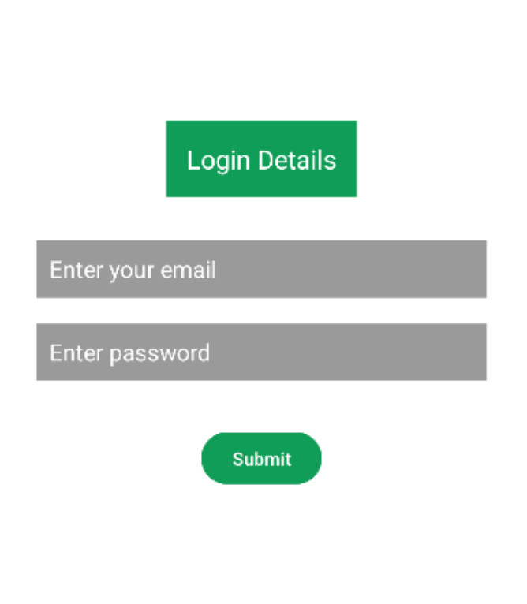
Example

Slide 84
example
<EditText
android:id="@+id/editText1“
android:layout_width="match_parent" android:layout_height="wrap_content" android:layout_marginTop="156dp" android:layout_gravity="center_horizontal" android:background="@color/grey" android:textColorHint="@color/white" android:hint="Enter your email" android:padding="10dp" />
<EditText
android:id="@+id/editText2" android:layout_width="match_parent" android:layout_height="wrap_content" android:layout_gravity="center_horizontal" android:layout_marginTop="220dp" android:background="@color/grey" android:textColorHint="@color/white" android:hint="Enter password" android:padding="10dp" /
<Button
android:id="@+id/button" android:layout_width="wrap_content" android:layout_height="wrap_content" android:layout_marginTop="300dp" android:backgroundTint="@color/green" android:layout_gravity="center_horizontal" android:text="Submit" />
</FrameLayout>
<?xml version="1.0" encoding="utf-8"?>
<FrameLayout xmlns:android="http://schemas.android.com/apk/res/android" xmlns:app="http://schemas.android.com/apk/res-auto" xmlns:tools="http://schemas.android.com/tools" android:id="@+id/main" android:layout_width="match_parent" android:layout_height="match_parent" android:padding="32dp" android:background="@color/white" tools:context=".MainActivity">
<TextView android:id="@+id/textView" android:layout_width="wrap_content" android:layout_height="wrap_content" android:layout_marginTop="64dp" android:layout_gravity="center_horizontal" android:background="@color/green" android:padding="16dp" android:text="Login Details" android:textColor="#FFFFFF" android:textSize="20sp" />

Slide 85
Scroll layout
It is a view group that is used to make vertically scrollable views. A scroll view contains a single direct child only. In order to place multiple views in the scroll view, one needs to make a view group(like LinearLayout) as a direct child and then we can define many views inside it. A ScrollView supports Vertical scrolling only, so in order to create a horizontally scrollable view, HorizontalScrollView is used.

Slide 86
Key Concepts
Single Child Rule: A ScrollView can only have one direct child view or view group. To include multiple elements, you must nest them inside a layout like LinearLayout or ConstraintLayout, and then place that single layout inside the ScrollView.
Vertical vs. Horizontal: ScrollView provides vertical scrolling by default. For horizontal scrolling, you must use HorizontalScrollView.
Avoid Nested Scrolling Containers: It is not recommended to place a ListView or RecyclerView inside a ScrollView, as these list components have their own built-in scrolling. Use a NestedScrollView from the AndroidX compatibility library if you specifically need complex nested scrolling behavior.

Slide 87
Example
<ScrollView xmlns:android="http://schemas.android.com/apk/res/android"
android:layout_width="match_parent"
android:layout_height="match_parent“
android:fillViewport="true">
<LinearLayout
android:layout_width="match_parent“
android:layout_height="wrap_content"
android:orientation="vertical"
android:padding="16dp">
<TextView
android:layout_width="wrap_content"
android:layout_height="wrap_content"
android:text="Title“/>
<TextView
android:layout_width="wrap_content"
android:layout_height="wrap_content"
android:layout_marginTop="8dp“
android:text=“title”/>
</LinearLayout>
</ScrollView>

Slide 88
Dialog
A Dialog is a small window that may appear in front of an activity in various forms.
Alert Dialog
Progress Dialog
DatePicker Dialog
TimePiker Dialog
If you want to display an alert message , then you can design alert dialog box.
AlertDialog is a small popup window used to display messages and get user confirmation with buttons like Yes/No/OK.

Slide 89
Alert Dialog
AlertDialog.Builder builder = new AlertDialog.Builder(this);
builder.setTitle("Title");
builder.setMessage("Message");
builder.setPositiveButton("Yes", null);
builder.setNegativeButton("No", null);
builder.show();

Slide 90
Example
btn.setOnClickListener(new View.OnClickListener() {
@Override
public void onClick(View v) {
AlertDialog.Builder builder = new AlertDialog.Builder(MainActivity.this);
builder.setTitle(“Exit");
builder.setMessage("Do you want to exit?");
builder.setCancelable(false)
builder.setPositiveButton("Yes", new DialogInterface.OnClickListener() {
@Override
public void onClick(DialogInterface dialog, int id) {
CreateDialogActivity.this. finish();
}
});
builder.setNegativeButton("No", new DialogInterface.OnClickListener() {
@Override
public void onClick(DialogInterface dialog, int id) {
dialog.cancel();
}
});
AlertDialog dialog = builder.create();
dialog.show();
}
});
}
}
import android.app.AlertDialog;
import android.content.DialogInterface;
import android.os.Bundle;
import android.view.View;
import android.widget.Button;
import androidx.appcompat.app.AppCompatActivity;
public class MainActivity extends AppCompatActivity {
Button btn;
@Override
protected void onCreate(Bundle savedInstanceState) {
super.onCreate(savedInstanceState);
setContentView(R.layout.activity_main);
btn = findViewById(R.id.button);

Slide 91
ProgressDialog
It is the extension of AlertDialog class , which is used to display the progress of a task in the form of spinning wheel or in the display format being set by you . You simply create the instance of ProgressDialog class and invoke the show() method.
ProgressDialog is used to show the progress of a task such as downloading, loading, or processing data.
By default, a Progress Dialog has a title, a message, and a circular progress bar that keeps rotating

Slide 92
ProgressDialog
ProgressDialog progressDialog; progressDialog = new ProgressDialog(this); progressDialog.setTitle("Loading"); progressDialog.setMessage("Please wait..."); progressDialog.setCancelable(false); progressDialog.show(); // Stop after some work progressDialog.dismiss();

Slide 93
Horizontal ProgressDialog
ProgressDialog progressDialog = new ProgressDialog(this);
progressDialog.setTitle("Downloading");
progressDialog.setMessage("Please wait...");
progressDialog.setProgressStyle(ProgressDialog.STYLE_HORIZONTAL);
progressDialog.setMax(100);
progressDialog.show();
// Increase progress
new Thread(new Runnable() {
public void run() {
for(int i = 0; i <= 100; i += 10){
try {
Thread.sleep(500);
progressDialog.setProgress(i);
} catch (Exception e) {
e.printStackTrace();
}
}
progressDialog.dismiss();
}
})
progressDialog.start();

Slide 94
TimePicker and DatePicker View
Time Picker:
A UI element that allows the user to select a time (hours and minutes).
Can display time in either a 12-hour or 24-hour format.
It has two modes: Spinner mode (where users scroll to select values) and Clock mode (where users select time using a visual clock interface).
Commonly used in apps for alarm or event scheduling.
Date Picker:
A UI element that allows the user to select a date (day, month, and year).
Provides a calendar-like interface where users can scroll through months and years.
Can be used either in spinner mode or as a calendar view.
Useful for selecting birthdates, scheduling events, or setting deadlines.

Slide 95
Adapter and AdapterView
In Android development, Adapter and AdapterView are key components in building UI elements that display dynamic data, such as lists or grids.
Adapters act as intermediaries between the data source and the UI components.
They work together to display data from a data source (like an array or database) and present it to the user in various UI elements such as ListView, GridView, or Spinner.
Relationship Between Adapter and AdapterView
Adapter: Supplies data to the AdapterView. It acts as a bridge between the data source and the UI.
AdapterView: Displays the data provided by the Adapter. It requests views from the Adapter and renders them on the screen.

Slide 96
Adapter
An Adapter in Android acts as a bridge between the data source (such as arrays, databases, or content providers) and the UI components (like ListView or GridView).
The adapter retrieves data from the source and inflates each item into a view that is displayed in the UI.
Common Adapter Types:
ArrayAdapter: Binds arrays or lists of data to views like ListView or Spinner.
CursorAdapter: Binds data from a Cursor (often from a SQLite database) to views.
BaseAdapter: A base class that can be extended to create custom adapters.
RecyclerView.Adapter: Specifically used with Recycler View, providing better performance for large datasets.

Slide 97
Key Methods in Adapter:
getView(): Returns the view for each item at a specific position in the dataset.
getCount(): Returns the number of items in the dataset.
getItem(): Retrieves the data at a specific position.
getItemId(): Returns the unique ID of a specific item.
Example:
ArrayAdapter<String> adapter = new ArrayAdapter<>(this, android.R.layout.simple_list_item_1, new String[] {"Apple", "Banana", "Cherry"});
ListView listView = findViewById(R.id.listView);
listView.setAdapter(adapter);
The Array Adapter Bind the array string to a list view.

Slide 98
AdapterView
An AdapterView is a UI component that depends on an adapter to display multiple items.
It is an abstract class that provides the base class for views like ListView, GridView, Spinner, and RecyclerView.
These views do not hold the data themselves; instead, they rely on an adapter to supply and manage the data.

Slide 99
Common Types of AdapterViews:
ListView: Displays a vertically scrollable list of items.
GridView: Displays items in a grid format.
Spinner: Displays a dropdown menu where the user can select an item.
RecyclerView: More advanced and flexible version of ListView with better performance, used to display large datasets.
Key Methods in AdapterView:
setAdapter(): Connects an adapter to the AdapterView( ex. ListView, GridView).
getAdapter(): Retrieves the current adapter used by the AdapterView.
setOnItemClickListener(): Sets a listener to handle click events on individual items.

Slide 100
Example of an AdapterView (ListView):
ListView listView = findViewById(R.id.listView);
ArrayAdapter<String> adapter = new ArrayAdapter<>( this,android.R.layout.simple_list_item_1, new String[] {"Apple", "Banana", "Cherry"});
listView.setAdapter(adapter);
*The ListView(an adapter View) is populated by the array Adapter, which provides the data (an array of string)

Slide 101
Example: XML Layout (activity_main.xml)
<LinearLayout
xmlns:android="http://schemas.android.com/apk/res/android"
android:layout_width="match_parent"
android:layout_height="match_parent"
android:orientation="vertical">
<ListView
android:id="@+id/listView"
android:layout_width="match_parent"
android:layout_height="wrap_content" />
</LinearLayout>

Slide 102
MainActivity.java
AdapterView: The ListView in this example is an AdapterView. It requires an adapter to supply the data.
Adapter: The ArrayAdapter in this case binds the fruits array to the ListView, generating a view for each fruit.
Interaction: The ListView interacts with the adapter to get the data and display it to the user.
import android.os.Bundle;
import android.widget.ArrayAdapter;
import android.widget.ListView;
import androidx.appcompat.app.AppCompatActivity;
public class MainActivity extends AppCompatActivity {
@Override
protected void onCreate(Bundle savedInstanceState) {
super.onCreate(savedInstanceState);
setContentView(R.layout.activity_main);
// Step 1: Reference the ListView
ListView listView = findViewById(R.id.listView);
// Step 2: Create an ArrayAdapter
String[] fruits = {"Apple", "Banana", "Cherry", "Date", "Fig"};
ArrayAdapter<String> adapter = new ArrayAdapter<>( this, android.R.layout.simple_list_item_1, fruits );
// Step 3: Set the Adapter to the ListView
listView.setAdapter(adapter);
}
}

Slide 103
Spinner View
Android Spinner is a view similar to the dropdown list which is used to select one option from the list of options.
It provides an easy way to select one item from the list of items and it shows a dropdown list of all values when we click on it.
The default value of the android spinner will be the currently selected value and by using Adapter we can easily bind the items to the spinner objects.

Slide 104
List<String> spinnerArray = new ArrayList<String>();
spinnerArray.add("item1"); spinnerArray.add("item2");
ArrayAdapter<String> adapter = new ArrayAdapter<String>( this, android.R.layout.simple_spinner_item, spinnerArray);
adapter.setDropDownViewResource(android.R.layout.simple_spinner_dropdown_item); Spinner sItems = (Spinner) findViewById(R.id.spinner1);
sItems.setAdapter(adapter);
to find out what is selected you could do something like this
String selected = sItems.getSelectedItem().toString(); if (selected.equals("what ever the option was")) { }

Slide 105
import android.os.Bundle;
import android.view.View;
import android.widget.AdapterView;
import android.widget.ArrayAdapter;
import android.widget.Spinner;
import android.widget.Toast;
import androidx.appcompat.app.AppCompatActivity;
public class MainActivity extends AppCompatActivity implements AdapterView.OnItemSelectedListener
{
private String[] courses = {
"C", "DBMS",
"java", "DAA",
"DS", "OS"
};
@Override
protected void onCreate(Bundle savedInstanceState) {
super.onCreate(savedInstanceState);
setContentView(R.layout.activity_main);

Slide 106
Spinner spin = findViewById(R.id.spinner);
spin.setOnItemSelectedListener(this);
ArrayAdapter<String> ad = new ArrayAdapter<>(
this,android.R.layout.simple_spinner_item, courses
);
ad.setDropDownViewResource(android.R.layout.simple_spinner_dropdown_item);
spin.setAdapter(ad);
public void onItemSelected(AdapterView<?> parent, View view, int position, long id) {
// Make toast of the name of the course which is selected in the spinner
Toast.makeText(getApplicationContext(), courses[position], Toast.LENGTH_SHORT).show();
}
@Override
public void onNothingSelected(AdapterView<?> parent) {
// No action needed when no selection is made
}
}

Slide 107
<?xml version="1.0" encoding="utf-8"?>
<androidx.constraintlayout.widget.ConstraintLayout
xmlns:android="http://schemas.android.com/apk/res/android"
xmlns:app="http://schemas.android.com/apk/res-auto"
xmlns:tools="http://schemas.android.com/tools"
android:layout_width="match_parent"
android:layout_height="match_parent"
android:background="@color/white"
tools:context=".MainActivity">
<!--Spinner widget-->
<Spinner
android:id="@+id/spinner"
android:layout_width="wrap_content"
android:layout_height="wrap_content"
android:paddingHorizontal="16dp"
android:paddingVertical="8dp"
app:layout_constraintBottom_toBottomOf="parent"
app:layout_constraintEnd_toEndOf="parent"
app:layout_constraintStart_toStartOf="parent"
app:layout_constraintTop_toTopOf="parent"/>
</androidx.constraintlayout.widget.ConstraintLayout>

Slide 108
Android Different Types of UI Controls
TextView
EditText
AutoCompleteTextView
Button
ImageButton
ToggleButton
CheckBox
RadioButton
RadioGroup

Slide 109
Check Box
<CheckBox android:id="@+id/chkAndroid" android:layout_width="wrap_content" android:layout_height="wrap_content" android:padding="10dp" android:layout_marginLeft="100dp" android:text="Android" android:onClick="onCheckboxClicked"/> <CheckBox android:id="@+id/chkAngular" android:layout_width="wrap_content" android:layout_height="wrap_content" android:padding="10dp" android:layout_marginLeft="100dp" android:text="AngularJS" android:onClick="onCheckboxClicked"/> <Button android:id="@+id/getBtn" android:layout_width="wrap_content" android:layout_height="wrap_content" android:layout_marginLeft="100dp" android:text="Get Details" /> </LinearLayout>
<?xml version="1.0" encoding="utf-8"?> <LinearLayout xmlns:android="http://schemas.android.com/apk/res/android" android:orientation="vertical" android:layout_width="match_parent" android:layout_height="match_parent"> <CheckBox android:id="@+id/chkJava" android:layout_width="wrap_content" android:layout_height="wrap_content" android:padding="10dp" android:layout_marginTop="150dp" android:layout_marginLeft="100dp" android:text="Java" android:onClick="onCheckboxClicked"/> <CheckBox android:id="@+id/chkPython" android:layout_width="wrap_content" android:layout_height="wrap_content" android:padding="10dp" android:layout_marginLeft="100dp" android:text="Python" android:onClick="onCheckboxClicked"/>

Slide 110
public class MainActivity extends AppCompatActivity { CheckBox android, java, angular, python; @Override protected void onCreate(Bundle savedInstanceState) { super.onCreate(savedInstanceState); setContentView(R.layout.activity_main); android = (CheckBox)findViewById(R.id.chkAndroid); angular = (CheckBox)findViewById(R.id.chkAngular); java = (CheckBox)findViewById(R.id.chkJava); python = (CheckBox)findViewById(R.id.chkPython); Button btn = (Button)findViewById(R.id.getBtn);
btn.setOnClickListener(new View.OnClickListener() { @Override public void onClick(View v) { String result = "Selected Courses"; if(android.isChecked()){ result += "\nAndroid"; } if(angular.isChecked()){ result += "\nAngularJS"; } if(java.isChecked()){ result += "\nJava"; } if(python.isChecked()){ result += "\nPython"; } Toast.makeText(getApplicationContext(), result, Toast.LENGTH_SHORT).show(); } }); }

Slide 111
public void onCheckboxClicked(View view)
{ boolean checked = ((CheckBox) view).isChecked(); String str=""; // Check which checkbox was clicked switch(view.getId()) { case R.id.chkAndroid: str = checked?"Android Selected":"Android Deselected"; break; case R.id.chkAngular: str = checked?"AngularJS Selected":"AngularJS Deselected"; break; case R.id.chkJava: str = checked?"Java Selected":"Java Deselected"; break; case R.id.chkPython: str = checked?"Python Selected":"Python Deselected"; break; } Toast.makeText(getApplicationContext(), str, Toast.LENGTH_SHORT).show(); } }

Slide 112
Radio Button:
In android, Radio Button is a two-states button that can be either checked or unchecked and it’s the same as CheckBox control, except that it will allow only one option to select from the group of options.
The user can press or click on the radio button to make it select. In android, CheckBox control allow users to change the state of control either Checked or Unchecked but the radio button cannot be unchecked once it is checked.
Generally, we can use RadioButton controls in an android application to allow users to select only one option from the set of values.
In android, we use radio buttons with in a RadioGroup to combine multiple radio buttons into one group and it will make sure that users can select only one option from the group of multiple options.
By default, the android RadioButton will be in OFF (Unchecked) state.
We can change the default state of RadioButton by using android:checked attribute.
In case, if we want to change the state of RadioButton to ON (Checked), then we need to set
android:checked = “true”
in our XML layout file.

Slide 113
<?xml version="1.0" encoding="utf-8"?> <RelativeLayout xmlns:android="http://schemas.android.com/apk/res/android" android:layout_width="match_parent" android:layout_height="match_parent"> <TextView android:layout_width="wrap_content" android:layout_height="wrap_content" android:layout_marginTop="150dp" android:layout_marginLeft="100dp" android:textSize="18dp" android:text="Select Your Course" android:textStyle="bold" android:id="@+id/txtView"/> <RadioGroup android:layout_width="match_parent" android:layout_height="wrap_content" android:orientation="vertical" android:id="@+id/rdGroup" android:layout_below="@+id/txtView"> <RadioButton android:id="@+id/rdbJava" android:layout_width="wrap_content" android:layout_height="wrap_content" android:padding="10dp" android:layout_marginLeft="100dp" android:text="Java" android:onClick="onRadioButtonClicked"/> <RadioButton android:id="@+id/rdbPython" android:layout_width="wrap_content" android:layout_height="wrap_content" android:padding="10dp" android:layout_marginLeft="100dp" android:text="Python" android:onClick="onRadioButtonClicked"/>
<RadioButton android:id="@+id/rdbAndroid" android:layout_width="wrap_content" android:layout_height="wrap_content" android:padding="10dp" android:layout_marginLeft="100dp" android:text="Android" android:onClick="onRadioButtonClicked"/> <RadioButton android:id="@+id/rdbAngular" android:layout_width="wrap_content" android:layout_height="wrap_content" android:padding="10dp" android:layout_marginLeft="100dp" android:text="AngularJS" android:onClick="onRadioButtonClicked"/> </RadioGroup> <Button android:id="@+id/getBtn" android:layout_width="wrap_content" android:layout_height="wrap_content" android:layout_marginLeft="100dp" android:layout_below="@+id/rdGroup" android:text="Get Course" /> </RelativeLayout>

Slide 114
public class MainActivity extends AppCompatActivity { RadioButton android, java, angular, python; @Override protected void onCreate(Bundle savedInstanceState) { super.onCreate(savedInstanceState); setContentView(R.layout.activity_main); android = (RadioButton)findViewById(R.id.rdbAndroid); angular = (RadioButton)findViewById(R.id.rdbAngular); java = (RadioButton)findViewById(R.id.rdbJava); python = (RadioButton)findViewById(R.id.rdbPython); Button btn = (Button)findViewById(R.id.getBtn); btn.setOnClickListener(new View.OnClickListener() { @Override public void onClick(View v) { String result = "Selected Course: "; result+= (android.isChecked())?"Android":(angular.isChecked())?"AngularJS":(java.isChecked())?"Java":(python.isChecked())?"Python":""; Toast.makeText(getApplicationContext(), result, Toast.LENGTH_SHORT).show(); } }); }

Slide 115
public void onRadioButtonClicked(View view) { boolean checked = ((RadioButton) view).isChecked(); String str=""; // Check which radio button was clicked switch(view.getId()) { case R.id.rdbAndroid: if(checked) str = "Android Selected"; break; case R.id.rdbAngular: if(checked) str = "AngularJS Selected"; break; case R.id.rdbJava: if(checked) str = "Java Selected"; break; case R.id.rdbPython: if(checked) str = "Python Selected"; break; } Toast.makeText(getApplicationContext(), str, Toast.LENGTH_SHORT).show(); } }

Slide 116
In android, Radio Group is used to group one or more radio buttons into separate groups based on our requirements.
If we group Radio Buttons using RadioGroup, at a time only one item can be selected from the group of radio buttons. In case, if we select one radio button that belongs to a radio group will unselect all other previously selected radio buttons within the same group.
Initially, all the radio buttons of the radio group are in the unchecked state, once we select a radio button then it’s not possible for us to uncheck it like CheckBox control.

Slide 117
Storage option
The preferences
Internal storage
External storge
SQLite data base
The content provider

Slide 118
SharedPreferences
SharedPreferences is an Android API used to store and retrieve small amounts of primitive data as key-value pairs. It is ideal for application settings, login sessions, or user preferences that must persist even if the app is closed or the device is rebooted.
Each SharedPreferences file is managed by the framework and can be private or shared.
Notes: DataStore is a modern data storage solution that you should use instead of SharedPreferences. It builds on Kotlin coroutines and Flow, and overcomes many of the drawbacks of SharedPreferences.

Slide 119
1. Initialize SharedPreferences
You can create a new shared preference file or access an existing one by calling one of these methods: -
getSharedPreferences(String name, int mode ): Use this if you need multiple shared preference files identified by name, which you specify with the first parameter. You can call this from any Context in your app.
getPreferences(int mode): Use this from an Activity if you need to use only one shared preference file for the activity. Because this retrieves a default shared preference file that belongs to the activity, you don't need to supply a name.

Slide 120
Example
MODE_PRIVATE ensures only your app can access the file
SharedPreferences sharedPref = getSharedPreferences("MyPrefs", Context.MODE_PRIVATE);
Or
The following code accesses the shared preferences file that's identified by the resource string R.string.preference_file_key and opens it using the private mode so the file is accessible by only your app:
Context context = getActivity();
SharedPreferences sharedPref=context.getSharedPreferences(getString(R.string.preference_file_key), Context.MODE_PRIVATE);
if you need just one shared preference file for your activity, you can use the getPreferences() method:
SharedPreferences sharedPref = getActivity().getPreferences(Context.MODE_PRIVATE);

Slide 121
2. Write Data
To write to a shared preferences file, create SharedPreferences.Editor by calling edit() on your SharedPreferences.
Pass the keys and values you want to write with methods such as: putInt() and putString().
Then call apply() or commit() to save the changes.
Example:
SharedPreferences sharedPref = getActivity().getPreferences(Context.MODE_PRIVATE);
SharedPreferences.Editor editor = sharedPref.edit();
editor.putInt(getString(R.string.saved_high_score_key), newHighScore); editor.apply();
apply(): Changes are made immediately in memory but written to disk asynchronously. It does not return a value.
commit(): Writes data synchronously and returns true if successful. Avoid calling this from the main UI thread as it can block execution.

Slide 122
3. Read Data
To retrieve values from a shared preferences file, call methods such
as getInt() and getString(), providing the key for the value you want, and optionally a default value to return if the key isn't present.
String name = sharedPref.getString("username", "Default Name");
int score = sharedPref.getInt("high_score", 0);
4.Delete Data
Remove a specific key:
editor.remove("key_name").apply();.
Clear all data:
editor.clear().apply();

Slide 123
example
public class MainActivity extends AppCompatActivity
{ private EditText nameEditText;
private EditText ageEditText;
protected void onCreate(Bundle savedInstanceState)
{ super.onCreate(savedInstanceState); setContentView(R.layout.activity_main);
// Initializing EditText fields
nameEditText = findViewById(R.id.edit1);
ageEditText = findViewById(R.id.edit2);
}
@Override
protected void onResume()
{ super.onResume();
// Retrieving stored data from SharedPreferences
SharedPreferences sharedPreferences = getSharedPreferences("UserPreferences", MODE_PRIVATE);
String savedName = sharedPreferences.getString("user_name", "");
int savedAge = sharedPreferences.getInt("user_age", 0);

Slide 124
// Populating EditText fields with stored data
nameEditText.setText(savedName);
ageEditText.setText(savedAge > 0 ? String.valueOf(savedAge) : "");
} @Override protected
void onPause() {
super.onPause();
// Storing data in SharedPreferences
SharedPreferences sharedPreferences = getSharedPreferences("UserPreferences", MODE_PRIVATE);
SharedPreferences.Editor editor = sharedPreferences.edit();
// Retrieving user input and saving it
editor.putString("user_name", nameEditText.getText().toString());
String ageInput = ageEditText.getText().toString();
int userAge = ageInput.isEmpty() ? 0 : Integer.parseInt(ageInput);
editor.putInt("user_age", userAge);
editor.apply(); } }

Slide 125
Data Base in Android
In Android, a database is commonly used to store structured data persistently within the application. One of the most common ways to store data in Android is using SQLite, a lightweight, self-contained SQL database engine. SQLite is used because it doesn't require a separate server process or system to manage the database.

Slide 126
Data Base in Android
Basic Concepts
SQLite Database: It is a relational database that stores data in tables (rows and columns).
SQLiteOpenHelper: This is a helper class that simplifies database management, such as creating or upgrading databases.

Slide 127
Steps to create data base:
Create a database helper class to manage the SQLite database.
Create a model class to represent the data (User).
Insert data into the database and retrieve data from it.

Slide 128
Create a Database Helper Class
import android.content.Context;
import android.database.sqlite.SQLiteDatabase;
import android.database.sqlite.SQLiteOpenHelper;
public class DatabaseHelper extends SQLiteOpenHelper {
// Database Info
private static final String DATABASE_NAME = "user_db";
private static final int DATABASE_VERSION = 1;
// Table Info
public static final String TABLE_USER = "user";
public static final String COLUMN_ID = "id";
public static final String COLUMN_NAME = "name";
public static final String COLUMN_EMAIL = "email";
// Create table SQL query
private static final String TABLE_CREATE =
"CREATE TABLE " + TABLE_USER + " (" +
COLUMN_ID + " INTEGER PRIMARY KEY AUTOINCREMENT, " +
COLUMN_NAME + " TEXT, " +
COLUMN_EMAIL + " TEXT);";

Slide 129
Create a Database Helper Class
public DatabaseHelper(Context context) {
super(context, DATABASE_NAME, null, DATABASE_VERSION);
}
// Called when the database is created for the first time
@Override
public void onCreate(SQLiteDatabase db) {
db.execSQL(TABLE_CREATE);
}
// Called when the database needs to be upgraded (if the version number is changed)
@Override
public void onUpgrade(SQLiteDatabase db, int oldVersion, int newVersion) {
db.execSQL("DROP TABLE IF EXISTS " + TABLE_USER);
onCreate(db);
}
}

Slide 130
Create a Model Class
public class User {
private int id;
private String name;
private String email;
public User(int id, String name, String email) {
this.id = id;
this.name = name;
this.email = email;
}
// Getter and Setter methods for id, name, and email
public int getId() {
return id;
}

Slide 131
Create a Model Class
public void setId(int id) {
this.id = id;
}
public String getName() {
return name;
}
public void setName(String name) {
this.name = name;
}
public String getEmail() {
return email;
}
public void setEmail(String email) {
this.email = email;
}
}

Slide 132
Insert and Retrieve Data from the Database
import android.content.ContentValues;
import android.database.Cursor;
import android.database.sqlite.SQLiteDatabase;
import android.os.Bundle;
import android.widget.Toast;
import androidx.appcompat.app.AppCompatActivity;
public class MainActivity extends AppCompatActivity {
DatabaseHelper dbHelper;
@Override
protected void onCreate(Bundle savedInstanceState) {
super.onCreate(savedInstanceState);
setContentView(R.layout.activity_main);
dbHelper = new DatabaseHelper(this);
// Insert a new user into the database
insertUser("John Doe", "john.doe@example.com");
// Retrieve and display all users
getUsers();
}

Slide 133
Insert and Retrieve Data from the Database
// Method to insert a user
private void insertUser(String name, String email) {
SQLiteDatabase db = dbHelper.getWritableDatabase();
// Create a ContentValues object to hold the values to insert
ContentValues values = new ContentValues();
values.put(DatabaseHelper.COLUMN_NAME, name);
values.put(DatabaseHelper.COLUMN_EMAIL, email);
// Insert the user into the database
long newRowId = db.insert(DatabaseHelper.TABLE_USER, null, values);
// Show a toast message with the row ID
if (newRowId != -1) {
Toast.makeText(this, "User inserted with ID: " + newRowId, Toast.LENGTH_SHORT).show();
}
}
// Method to retrieve and display all users
private void getUsers() {
SQLiteDatabase db = dbHelper.getReadableDatabase();

Slide 134
Insert and Retrieve Data from the Database
// Define the columns we want to retrieve
String[] projection = {
DatabaseHelper.COLUMN_ID,
DatabaseHelper.COLUMN_NAME,
DatabaseHelper.COLUMN_EMAIL
};
// Query the database
Cursor cursor = db.query(
DatabaseHelper.TABLE_USER, // Table name
projection, // Columns to return
null, // WHERE clause (no filter)
null, // WHERE arguments
null, // GROUP BY
null, // HAVING
null // ORDER BY (optional)
);

Slide 135
Insert and Retrieve Data from the Database
// Loop through the result set and show each user
while (cursor.moveToNext()) {
int id = cursor.getInt(cursor.getColumnIndexOrThrow(DatabaseHelper.COLUMN_ID));
String name = cursor.getString(cursor.getColumnIndexOrThrow(DatabaseHelper.COLUMN_NAME));
String email = cursor.getString(cursor.getColumnIndexOrThrow(DatabaseHelper.COLUMN_EMAIL));
// Display the user information
Toast.makeText(this, "ID: " + id + ", Name: " + name + ", Email: " + email, Toast.LENGTH_SHORT).show();
}
cursor.close();
}
}

Slide 136
The application consists of 5 classes. We begin with defining with DatabaseHelper, which is a subclass of SQLiteOpenHelper as follows: DatabaseHelper.java

Slide 137
Event handling
Event handling in Android is the process of capturing and responding to user interactions, such as clicks, touches, and key presses, using the Android framework's event management system

Slide 138
Core Concept
Event Listeners: Interfaces within the Android View class containing a single callback method (e.g., OnClickListener). These are triggered when the user interacts with a UI component.
Event Handlers: The actual callback methods (e.g., onClick()) where developers define the specific logic to execute in response to an event.
Event Registration: The process of associating an event listener with a specific view so the framework knows which handler to call.

Slide 139
Common Event Listeners & Handlers
OnClickListener onClick() Single tap or click on a View.
OnLongClickListener onLongClick() Holding a View for one second or more.
OnTouchListener onTouch() Any touch screen interaction (press, release, or move).
OnKeyListener onKey() Pressing or releasing a hardware key while focused.
OnFocusChangeListener onFocusChange() Navigating onto or away from a View.

